Slide 2

Minor-1 Project
FINAL PRESENTATION
CABLE LAYING PROBLEM ANALYSIS
Submitted By:
Under the guidance of
Mr. SUDHANSHU SRIVASTAVA
Assistant Professor
School of Computer Science & Engineering
Name | SAP ID
Ansh Payal | 500069289(07)
Ashish Negi | 500063799(11)
Kirti Kalra | 500067872(28)
Komal Sani | 500069287(29)

Slide 3
OVERVIEW
Project Title
Problem statement
Introduction
Literature review
Objective & Sub-Objective
Working and Flow charts
Code snippet and output
References

Slide 4
CABLE LAYING PROBLEM ANALYSIS

Slide 5
PROBLEM STATEMENT
We want to connect phone lines to a company, but laying down cable is expensive and time consuming. How can we minimize the amount of wire we must install and what is the best procedure to lay the wire so that the time consumption is less ?

Slide 6
INTRODUCTION
In the present scenario an algorithm and data structure play a significant role for the implementation and design of any software. An Algorithm is a finite sequential set of instructions which, if followed, accomplish a particular task or a set of tasks in a finite time.
The complexity of an Algorithm is a function g(n) that gives the upper bound of the number of operations performed by an algorithm when the input size is n. Complexity are divided in two ways: Time and space complexity. In case of algorithm minimum spanning tree is used to find the minimum cost. For example:
Suppose you want to apply a set of houses with:
Electric Power, Water ,Telephone lines or Sewage lines
To reduce cost, you can connect houses with minimum cost spanning trees.

Slide 7
While analyzing an algorithm, we mostly consider time complexity and space complexity.
Time complexity of an algorithm quantifies the amount of time taken by an algorithm to run as a function of the length of the input.
Space complexity of an algorithm quantifies the amount of space or memory taken by an algorithm to run as a function of the length of the input.
Time and space complexity depends on lots of things like hardware, operating system, processors, etc. However, we don't consider any of these factors while analyzing the algorithm. We will only consider the execution time of an algorithm.

Slide 8
MINIMUM SPANNING TREE
Prim’s Minimum Spanning Tree: It starts with an empty spanning tree. Prim's algorithm is a greedy algorithm that finds a minimum spanning tree for a weighted undirected graph. This means it finds a subset of the edges that forms a tree that includes every vertex, where the total weight of all the edges in the tree is minimized. The algorithm operates by building this tree one vertex at a time, from an arbitrary starting vertex, at each step adding the cheapest possible connection from the tree to another vertex.
Kruskal Minimum Spanning Tree: Kruskal's algorithm finds a minimum spanning forest of an undirected edge-weighted graph. If the graph is connected, it finds a minimum spanning tree. (A minimum spanning tree of a connected graph is a subset of the edges that forms a tree that includes every vertex, where the sum of the weights of all the edges in the tree is minimized. For a disconnected graph, a minimum spanning forest is composed of a minimum spanning tree for each connected component.) It is a greedy algorithm in graph theory as in each step it adds the next lowest-weight edge that will not form a cycle to the minimum spanning forest.

Slide 9
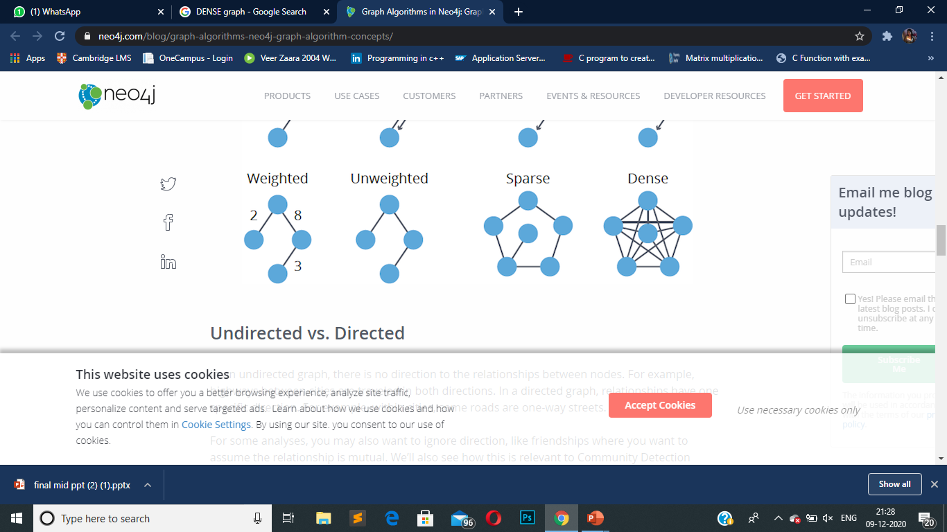
SPARSE AND DENSE GRAPH
Sparse graph is a graph in which the number of edges is close to the minimal number of edges. Sparse graph can be a disconnected graph.
Dense graph is a graph in which the number of edges is close to the maximal number of edges.

Slide 10
DIFFRENCE BETWEEN PRIM’S AND KRUSKAL ALGORITHMS
PRIMS ALGORITHM | KRUSKAL’S ALGORITHM
The Tree that we are making or growing always remains connected. | The tree that we are making or growing usually remains disconnected
Prim’s Algorithm grows a solution from a random vertex by adding the next cheapest vertex to the existing tree | Kruskal’s Algorithm grows a solution from the cheapest edge by adding the next cheapest edge to the existing tree.
Prim’s Algorithm is faster for dense graphs | Kruskal’s Algorithm is faster for sparse graphs.

Slide 11
LITERATURE REVIEW
●In computer science, Prim's algorithm finds a minimum spanning tree for a weighted undirected graph. The algorithm operates by building this tree one vertex at a time .The algorithm was developed in 1930 by Czech mathematician Vojtěch Jarník and later rediscovered and republished by computer scientists Robert C. Prim in 1957 and Edsger W. Dijkstra in 1959.
●Other well-known algorithm for this problem include Kruskal's algorithm. The Kruskal–Wallis test was developed in 1952 by Kruskal, W.H. and Wallis, W.A.. Kruskal's algorithm finds a minimum spanning forest of an undirected edge-weighted graph. It finds a minimum spanning tree by graph theory as in each step it adds the next lowest-weight edge that will not form a cycle to the minimum spanning forest.

Slide 12
OBJECTIVE
The main objective of our project is to use minimum spanning tree algorithm to solve cable laying problem.
SUB OJECTIVE
Apply Prims and Kruskal's Algorithm.
Calculate Time and Space complexity.
Check the execution performance of program in reference to sparse and dense graph
To achieve this, we implement and evaluate the complexity of the Prim’s and Kruskal’s algorithm and their performances in sparse and dense graph. In this project both methods have been implemented on a telecommunications company trying to lay cable in a new neighbourhood

Slide 13
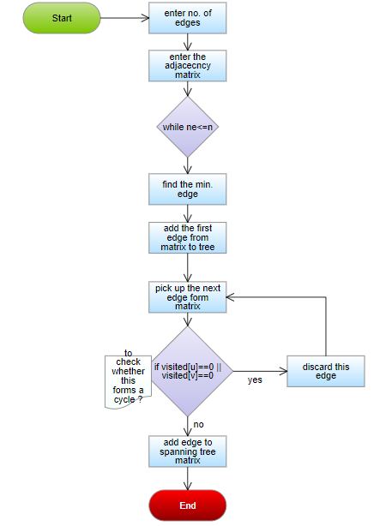
WORKING PRIM’S ALGORITHM
We are using the adjacency matrix method.
Step 1: Enter number of vertices and adjacency matrix.
Step 2: Mark visited[1] array= 1 because we are starting with the first node.
Step 3: Run “while” loop till no. of edges is less than no. of nodes
Step 4: Inside “while” loop run “for” loop for selecting the adjacent minimum cost edge from the selected node.

Slide 14
Step 5: After getting the minimum edge. Check for the cycle in the graph
Step 6: For avoiding the cycle or loop in graph we are checking the visited[] array. If the selected nodes are already visited(mark as 1) then we avoid that edge.
Step 7: Else we select that edge and sum its value to mincost.
Step 8: Repeat Step 3 until no. of edges is one less than no. of nodes.

Slide 15
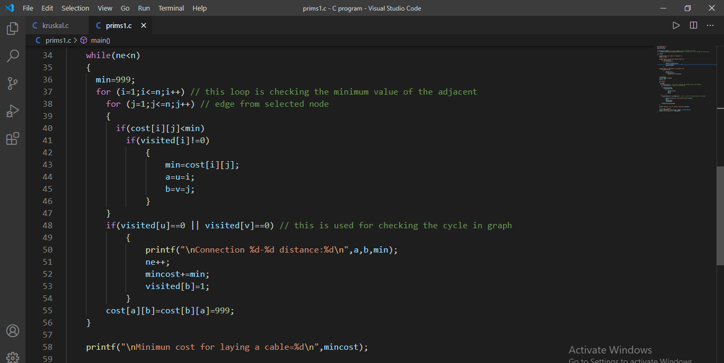
CODE SNIPPET OF PRIMS ALGORITHM

Slide 16
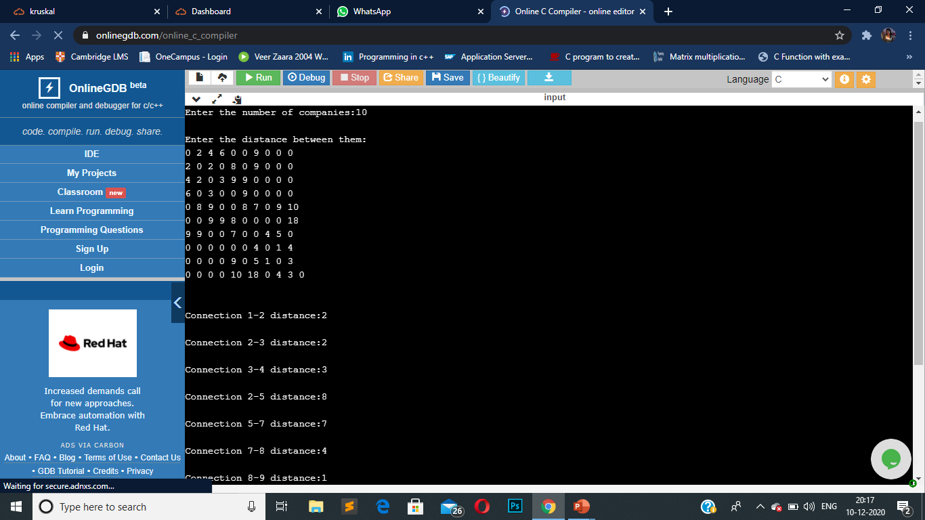
OUTPUT FOR SPARSE GRAPH

Slide 17
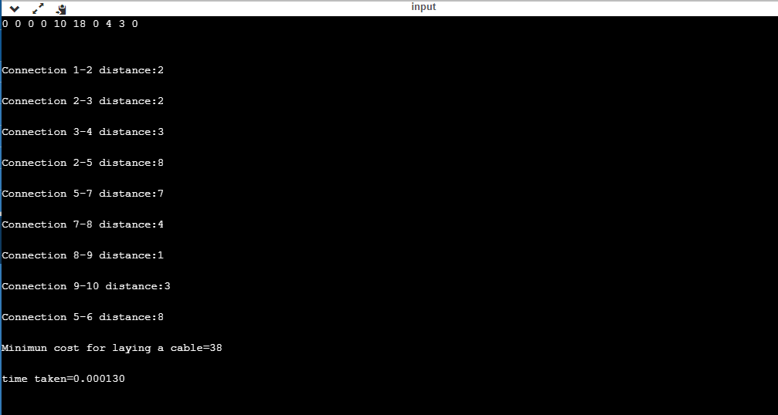

Slide 18
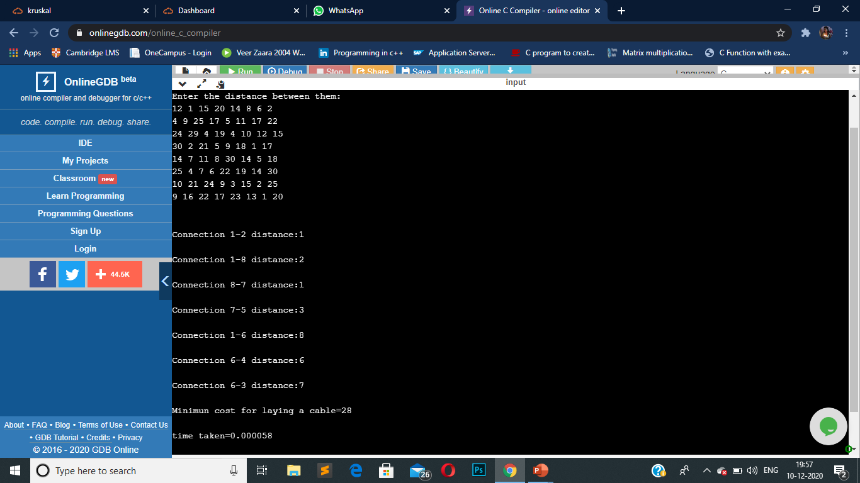
OUTPUT FOR DENSE GRAPH

Slide 19
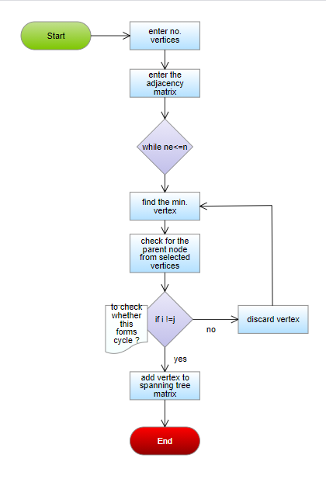
WORKING KRUSKAL ALGORITHM
We are using the adjacency matrix method
Step 1: Enter number of vertices and adjacency matrix.
Step 2: Run “while” loop till no. of edges is less than no. of nodes
Step 3: Find the minimum value from the given matrix using “for” loop.
Step 4: Before adding them into MST we are going to check the parent of selected nodes.

Slide 20
Step 5: For finding the parent of selected vertices we are using Find() function in program.
Step 6: If both the vertices have same parent then they will form the loop and for checking that we are using union() function.
Step 7: Union() function check if the parent of vertices is different then include that edge
Step 8: Else discard it.
Step 9: Repeat Step 2 until no. edge is less than no. of vertices.

Slide 21
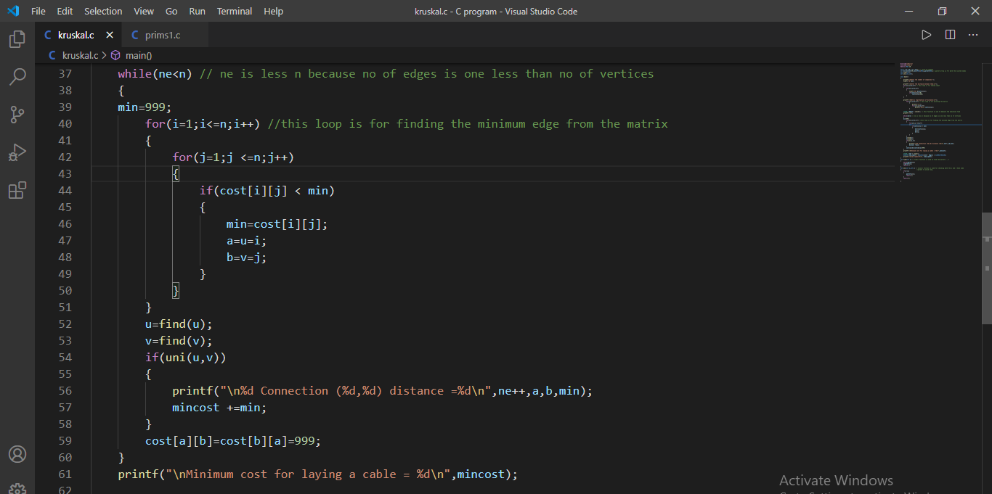
CODE SNIPPET OF KRUSKAL’S ALGORITHM

Slide 22
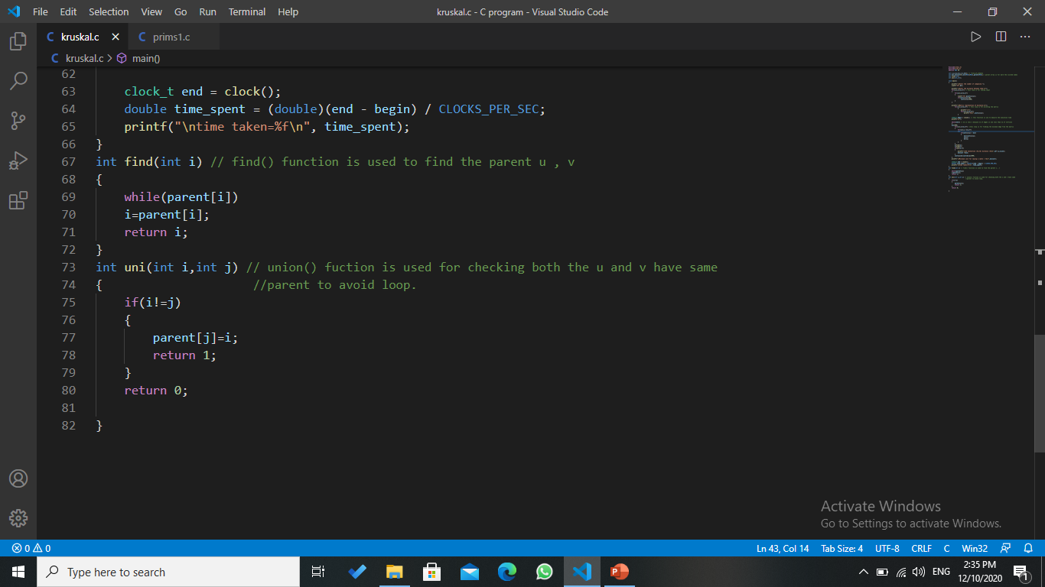

Slide 23
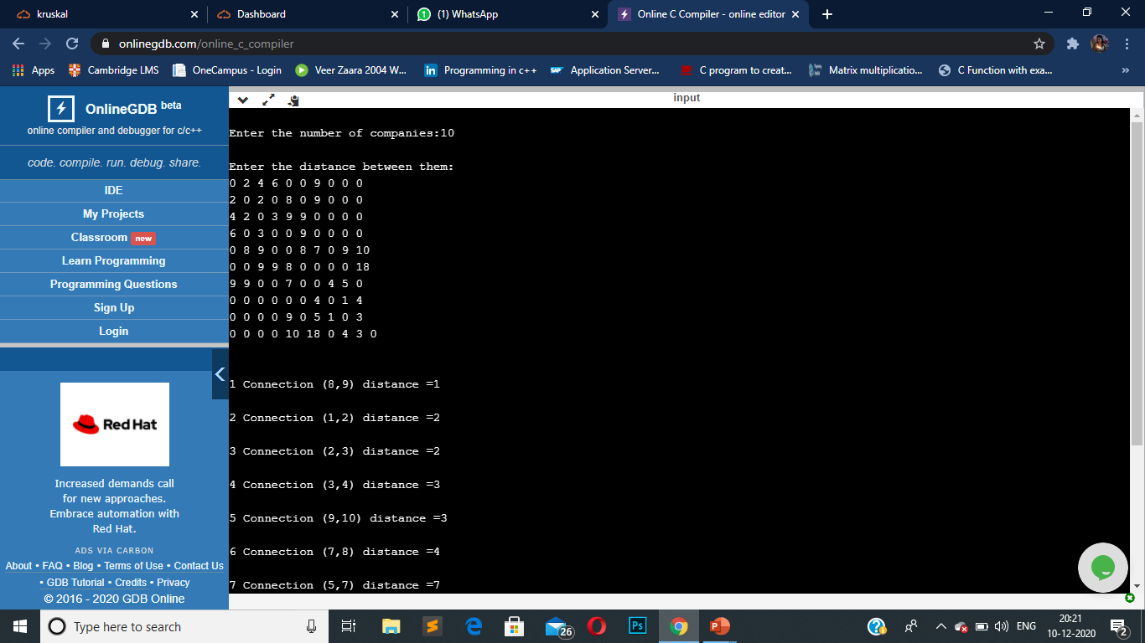
OUTPUT FOR SPARSE GRAPH

Slide 24
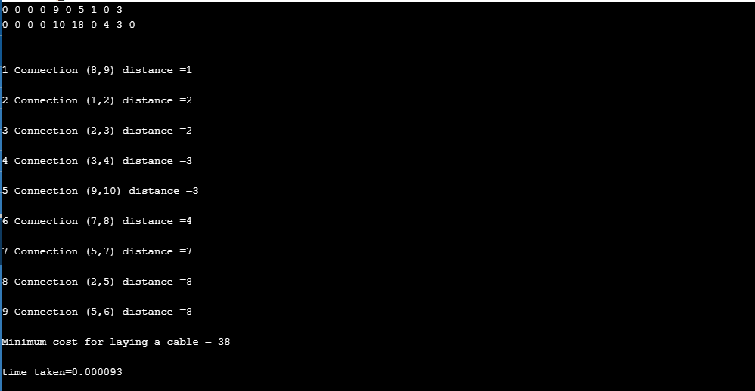

Slide 25
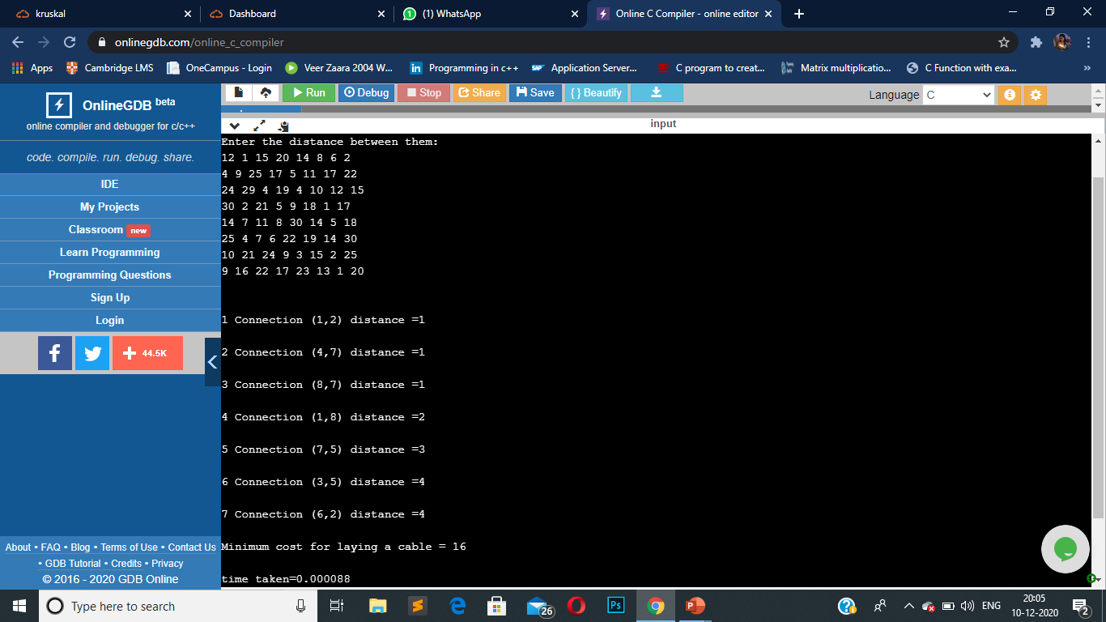
OUTPUT FOR DENSE GRAPH

Slide 26
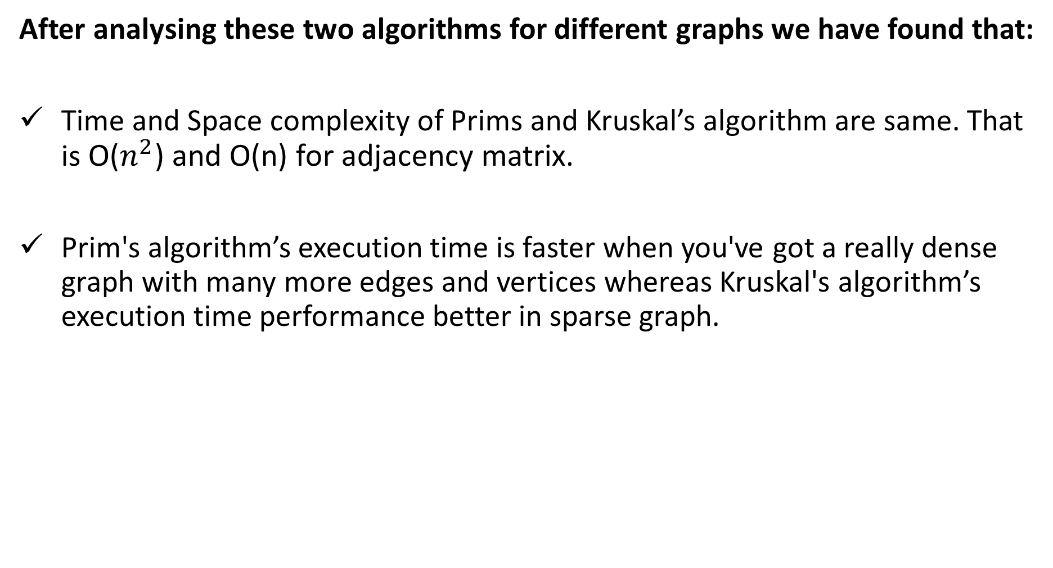
After analysing these two algorithms for different graphs we have found that:
Time and Space complexity of Prims and Kruskal’s algorithm are same. That is O($n^{2}$) and O(n) for adjacency matrix.
Prim's algorithm’s execution time is faster when you've got a really dense graph with many more edges and vertices whereas Kruskal's algorithm’s execution time performance better in sparse graph.

Slide 27
REFERENCES
https://www.hackerearth.com/blog/developers/kruskals-minimum-spanning-tree-algorithm-example/
https://www.geeksforgeeks.org/applications-of-minimum-spanning-tree/
https://www.geeksforgeeks.org/kruskals-minimum-spanning-tree-algorithm-greedy-algo-2/
https://www.geeksforgeeks.org/prims-minimum-spanning-tree-mst-greedy-algo-5/
https://stackoverflow.com/questions/5248915/execution-time-of-c-program#:~:text=To%20get%20the%20CPU%20time,as%20a%20floating%20point%20type.
https://www.techiedelight.com/find-execution-time-c-program/
P. Ayegba, J. Ayoola, E. Asani and A. Okeyinka, "A Comparative Study of Minimal Spanning Tree Algorithms," 2020 International Conference in Mathematics, Computer Engineering and Computer Science (ICMCECS), Ayobo, Ipaja, Lagos, Nigeria.

Slide 28
THANK YOU

